Slide 1








Business Flow C2B VA Collection Solution
Korea
Hong Kong
1. Contractual Relationship
2. Contractual Relationship
7) provides Virtual Accounts
4. Payment for purchase
5) Request Virtual Account
4) Request Virtual Accounts
Buyer 1’s VA
Market Place
Confirm Buyer 1
8. KRW Deposit
6) Issues Virtual Account
Buyer 2’s VA
Confirm Buyer 2
Buyers
Buyer 3’s VA
Confirm Buyer 3
…
9) Deposit Notification
…
10. FX & settle to PingPong
3) Online Shopping
Model A: (C2B)
PingPong & Buyer Contract
Buyer & Seller Contract
Info. Flow
Cash Flow

Slide 2
구매자 정보를 아래와 같습니다 :
구매자 이름
은행 명
은행 계좌번호
전화번호
입예정금액 (원하)
주문 ID(상품, 건 등)
개인 사업자 (주민등록번호, 사업자등록번호)
주소
영수증 (요청 필요)

Slide 3
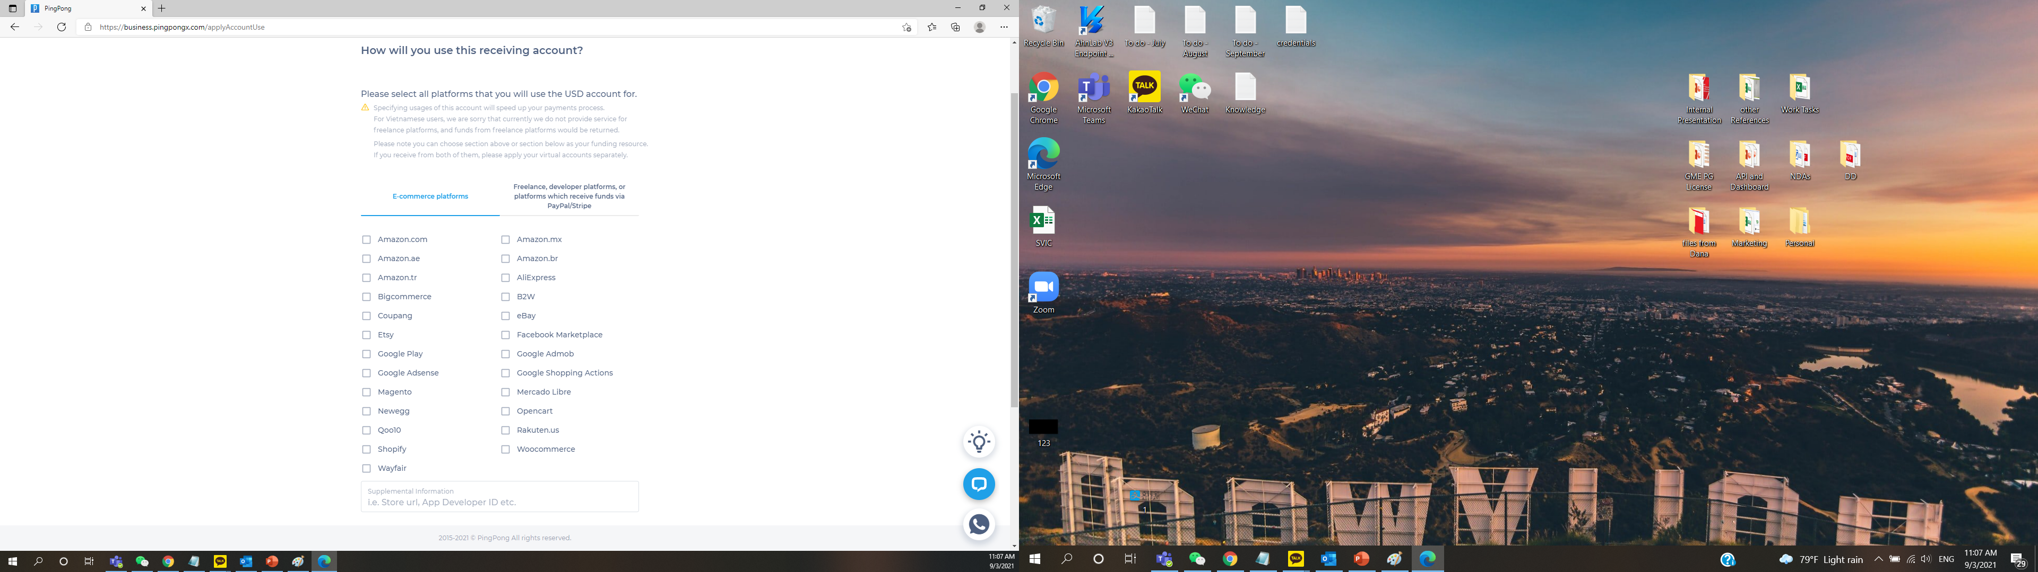
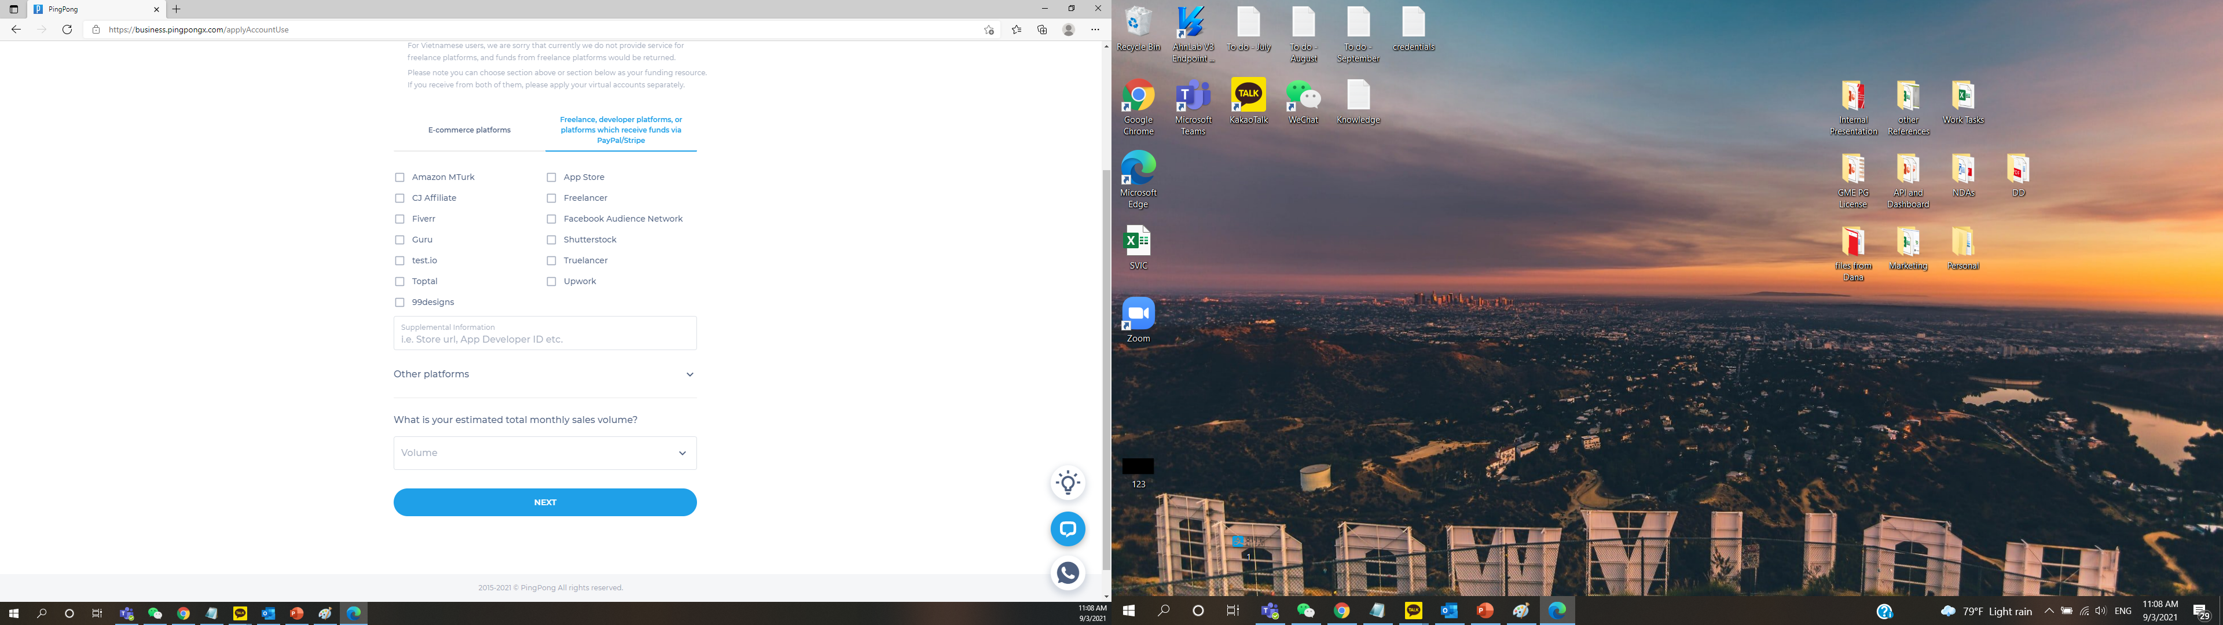

Slide 4




Business Flow B2B VA Collection Solution
Korea
China/US…
6. Deliver goods/service to consumer
8. Deposit Notifications
1. Registered as PingPong User
3. Assign virtual account to Merchants
7. Settle to seller virtual account per settlement cycle
5. Place order and make payment in local currency
CNY/USD/…
VA 1
2. Issue VA to PingPong
Seller Acct1
Customers
VA 2
Seller Acct2
Depositors
VA 3
Seller Acct3
…
Merchants
…
4. Gives VA details to Marketplaces (Depositors) in Korea
(B2B)
1. PingPong & Merchants Contract
2. Merchants & Depositors Contract
9. Conduct FX and settle to PingPong
Info. Flow
Cash Flow

Slide 5
Requirements for Bulk Virtual Accounts
List of Depositors into Virtual Accounts :
Apple Store, Amount (compliance or beneficiary)
Google Play
Naver
Amazon App Store
Google Adsense
Google Admob
Facebook Audience Network
Unity
Ironsource
AppLovin \
Vungle
Mopub
Tapjoy
Smaato
Tmon
Steam
Features of the Virtual Accounts :
Any Deposit out of the above listed will be rejected and put on hold for Suspicious Transactions, AML issues
One Virtual Account will be assigned to one Merchant, and account can be used for multiple times
Deposit Amount is not specified (not known before the deposit)
Validity of Virtual Account will open
Name of the Virtual Account will PingPong Payment
가상 계좌 특이사항:
상기 기재되어 있는 목록 외 다른 곳으로부터의 입금은 잠시 보류되며, 의심스러운 거래인지, AML이슈가 있는 지에 대해 확인 후 진행됩니다.
하나의 가상계좌는 하나의 업체에 제공되며, 여러 번 사용될 수 있습니다.
가상계좌의 유효 기간은 정해지지 않습니다.

